Slide 1
Module: Reverse Engineering
Functions and Frames
Yan Shoshitaishvili
Arizona State University

Slide 2
What is a program?
A program...
consists of modules...
that are made up of functions...
that contain blocks...
of instructions...
that operate on variables and data structures...
Let's drill down!

Slide 3
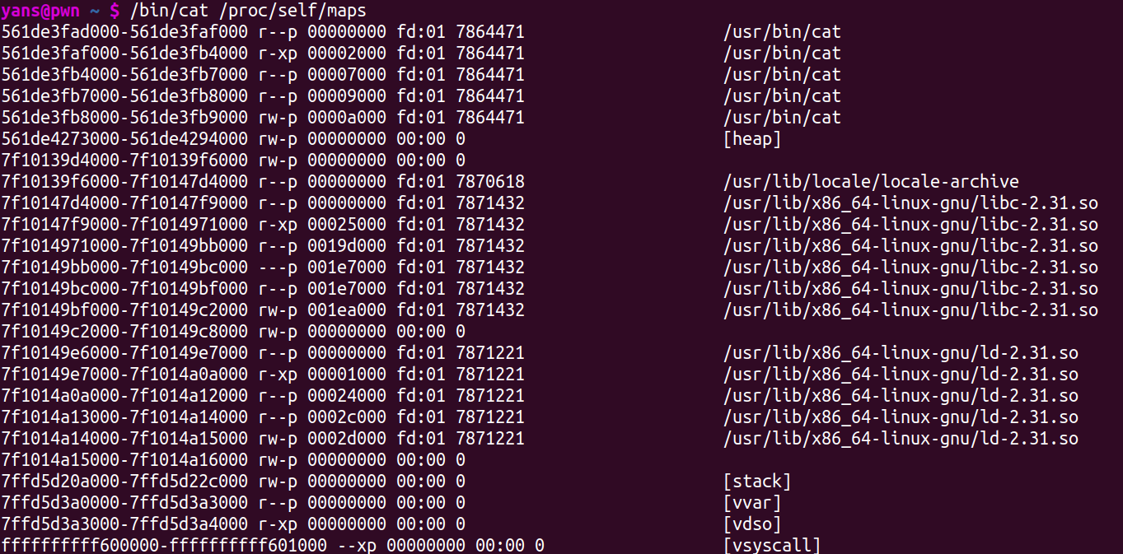
Modules
Developers (frequently) rely on libraries to build software. These libraries have well-documented functionality!
Read The Fine Manual of the libraries, and focus your reversing effort on your actual target!

Slide 4
Functions
Functions represent fairly well-encapsulated functionality.
Most functions have a well-defined goal such as:
set some data
calculate/retrieve/validate data
dispatch other functions
perform some action on the outside world (via system calls)
Initially, functions can be reverse-engineered in isolation. Later, you can build up an understanding of how they fit together.

Slide 5
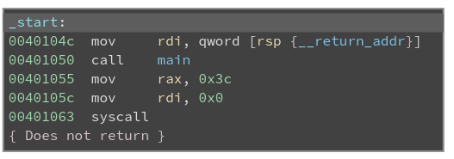
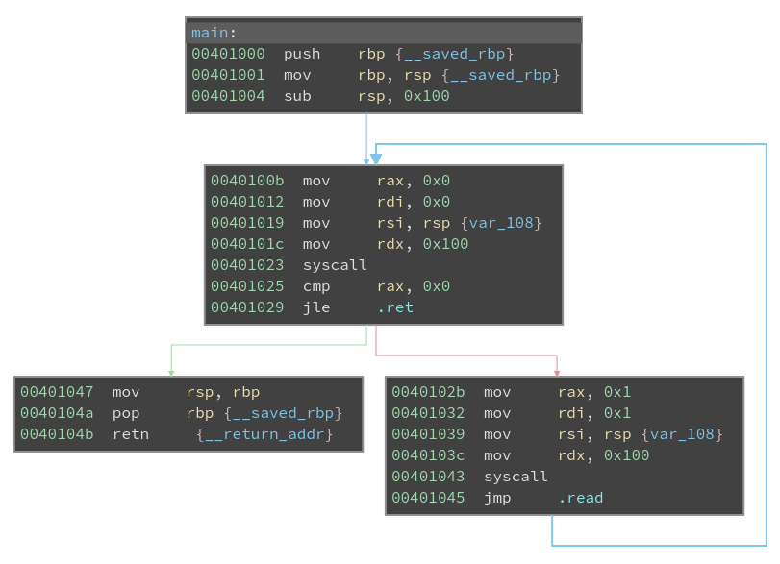
Functions: The Control Flow Graph
Functions are represented as a graph.
Each block is a set of instructions that will execute one after the other.
Blocks are joined by edges, representing conditional and unconditional jumps.
By understanding what the blocks do and what conditions trigger what edges, you can understand the function's logic!

Slide 6
Functions: Prologue
Functions often begin with a prologue and end with an epilogue.
Set up the stack frame.
Tear down the stack frame.

Slide 7
The Stack
Recall ELF sections (from the Fundamentals module):
.data: used for pre-initialized global writable data (such as global arrays with initial values)
.rodata: used for global read-only data (such as string constants)
.bss: used for uninitialized global writable data (such as global arrays without initial values)
But what about local variables?
The stack is a region of memory used to store local variables and call contexts.

Slide 8
The Stack Grows Backwards
Historical oddity: the stack grows backwards.
When you push to the stack, rsp is decreased by 8.
When you pop from the stack, rsp is increased by 8.
The stack is conceptualized vertically or horizontally.
Consider: push 0x41; push 0x42; push 0x43
0x00
0xFF
stack
Stac
stack
0x41
0x42
0x00
0xFF
stack
0x43
0x43
0x42
0x41
0x43
0x42
0x41
0xFF
0x00

Slide 9
The Stack: Initial Layout
The stack starts out storing (among some other things) the environment variables and the program arguments. For example:
$ env
USER=yans
HOME=/home/yans
PWD=/home/yans
$ ./program hello world
hello world
"./program\0"
"hello\0"
"world\0"
"USER=yans\0"
"HOME=/home/yans\0"
"PWD=/home/yans\0"
stack
argc
argv[0]
argv[1]
argv[2]
NULL
envp[0]
envp[1]
envp[2]
NULL

Slide 10
The Stack: Calling a Function
When a function is called, the address that the called function should return to is implicitly pushed onto the stack.
This return address is implicitly popped when the function returns.
"program\0"
"./program\0"
"hello\0"
"world\0"
"USER=yans\0"
"HOME=/home/yans\0"
"PWD=/home/yans\0"
stack
_start+3 0x401055
argc
argv[0]
argv[1]
argv[2]
NULL
envp[0]
envp[1]
envp[2]
NULL

Slide 11
The Stack: Function Frame Setup
Every function sets up its stack frame. It has:
Stack pointer (rsp): points to the leftmost side of the stack frame.
Base pointer (rbp): points to the rightmost side of the stack frame.
Prologue:
save off the caller's base pointer
set the current stack pointer as the base pointer
"allocate" space on the stack (subtract from the stack pointer).
our buffer
"program\0"
"./program\0"
"hello\0"
"world\0"
"USER=yans\0"
"HOME=/home/yans\0"
"PWD=/home/yans\0"
stack
saved rbp
_start+3 0x401055
argc
argv[0]
argv[1]
argv[2]
NULL
envp[0]
envp[1]
envp[2]
NULL

Slide 12
The Stack: Function Frame Teardown
Every function sets up its stack frame. It has:
Stack pointer (rsp): points to the leftmost side of the stack frame.
Base pointer (rbp): points to the rightmost side of the stack frame.
Epilogue:
"deallocate" the stack (mov rsp, rbp).
note: the data is NOT destroyed by default!
restore the old base pointer
Now, we are ready to return!
our buffer
"program\0"
"./program\0"
"hello\0"
"world\0"
"USER=yans\0"
"HOME=/home/yans\0"
"PWD=/home/yans\0"
stack
saved rbp
_start+3 0x401055
argc
argv[0]
argv[1]
argv[2]
NULL
envp[0]
envp[1]
envp[2]
NULL

Slide 13
-fomit-frame-pointer
Modern compilers can omit frame pointers in most cases, to allow rbp to be used as a general purpose register.
Don't panic!

